Slide 1


Slide 2
Action Plan
MIT Pitch 11/7

Slide 3
Goal of Pitching
Share Idea & Receive Feedback
Seeking mentors/professional who have similar interests
Gain connection and inform our team to the community
Developing & Expanding LucLoi & ASEAN Ecom team

Slide 4
Plan
Proof of problem: target market, customer, current solution(competitors)
Business Model and proof of value: our business model > how and why it works
Product: Features of LucLoi
Optional: operation plan, ideas are cheap > how we are going to validate and execute the idea
Use case: easy explanation

Slide 5
Plan
based on data that we have
From now to next Thursday >
Khue : problem
Huy: model
Cheryl : product
We meet again next Thursday and see how @@
ppt 3-5 slides > easy to understand!Alternative Pitching Technique:
Next Pitching (Problem, Business Model, Product):
Khue: Problem
Huy: Business Model
Cheryl: Product
Pitching & Discussion: Thursday 29th
Finalize LucLoi concept: 31st Saturday

Slide 6
Discussion
Discuss based on Lean canvas model: problems, less assumption
Xfers
use case mua ống nước: tìm đến địa điểm quen > buôn có bạn bán có phường
only focus on customer that are tech savvy> have a smart phone, how know to do
Our vision: 10-20 years later > that is our era :)

Slide 7
The Problem
Disorganised infrastructure.
Using social media as a primary platform to sell good ineffectively.
Lack of Online Marketplaces that target C2C model.

Slide 8

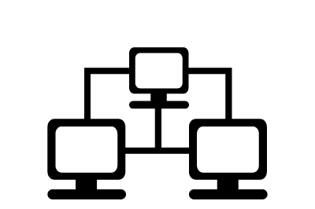


What is LucLoi.vn ?
C2C Online Marketplace for Vietnamese SMEs

Slide 9
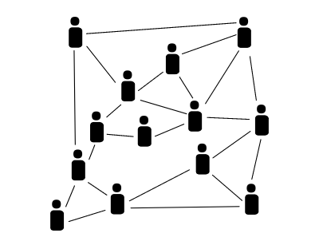
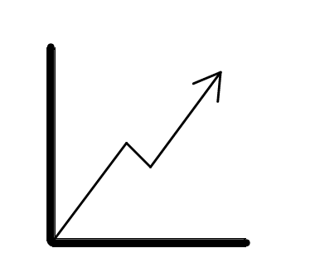

What is LucLoi.vn ?
Network & Search
A network that connect SMEs to consumers.
Opportunity to form more business relations.
Growth
Improve revenue by providing online presences and by expanding SMEs’ consumer base.
User Friendly
Better UI/UX for anyone with or w/o IT background.
Easy to setup and quick to get business running.

Slide 10
Vietnam has the Potential

Slide 11
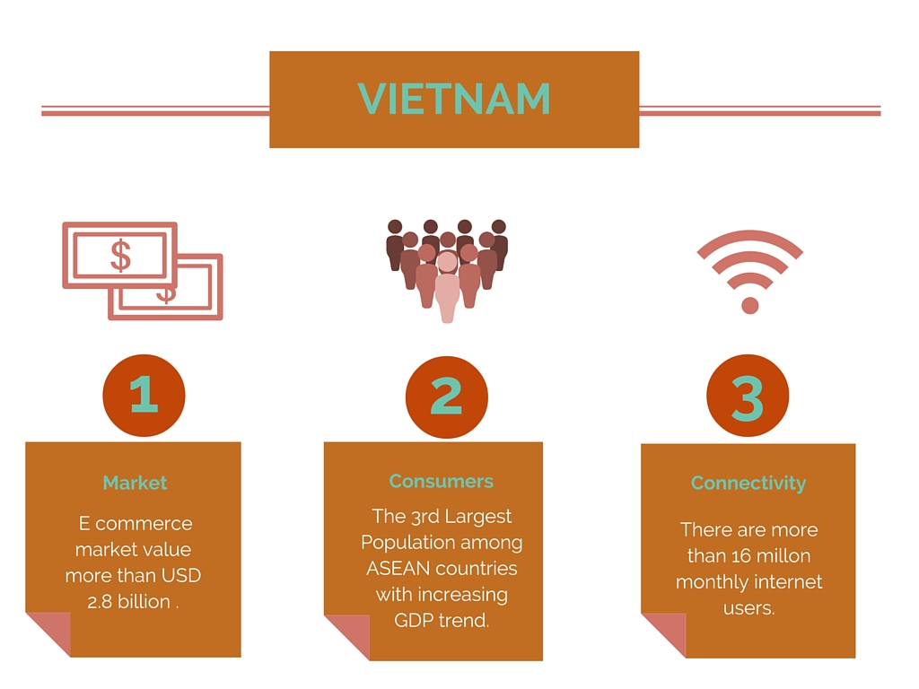

Slide 12
Why will LucLoi Work?
LucLoi adapts Alibaba’s model into Vietnam’s consumer behaviors.
Implements star ratings and user reviews as basis for establishing trust between the buyers and sellers.
The trend for online purchases is increasing.
###########################

Slide 13
Why will LucLoi Work?
The confidence in buying online has improved.
Internet in Vietnam is readily accessible and technology is affordable.
Vietnamese smartphone users are 36% of the nation’s population, that is 33 million.
The earning population accounts for 44.8% of the population from between
25-54 years old.
##################################################

Slide 14



How to Gain Traction
Share
Sharing using social media and SEO optimised.
Business
Through Physical storefront promotions and external advertisement.
Community
Spread by the word of mouth.
Refer
Users will be rewarded for every new user they refer when that user makes their first purchase, creating viral loop.

Slide 15
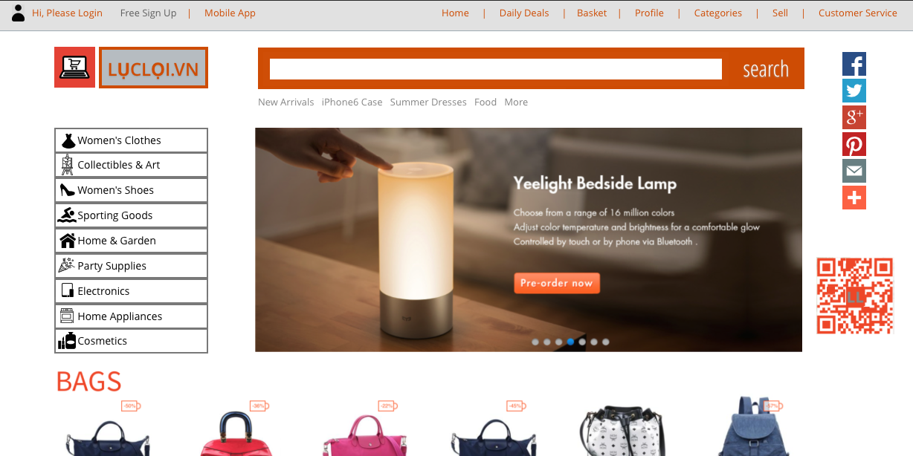
User Experience Outline

Slide 16
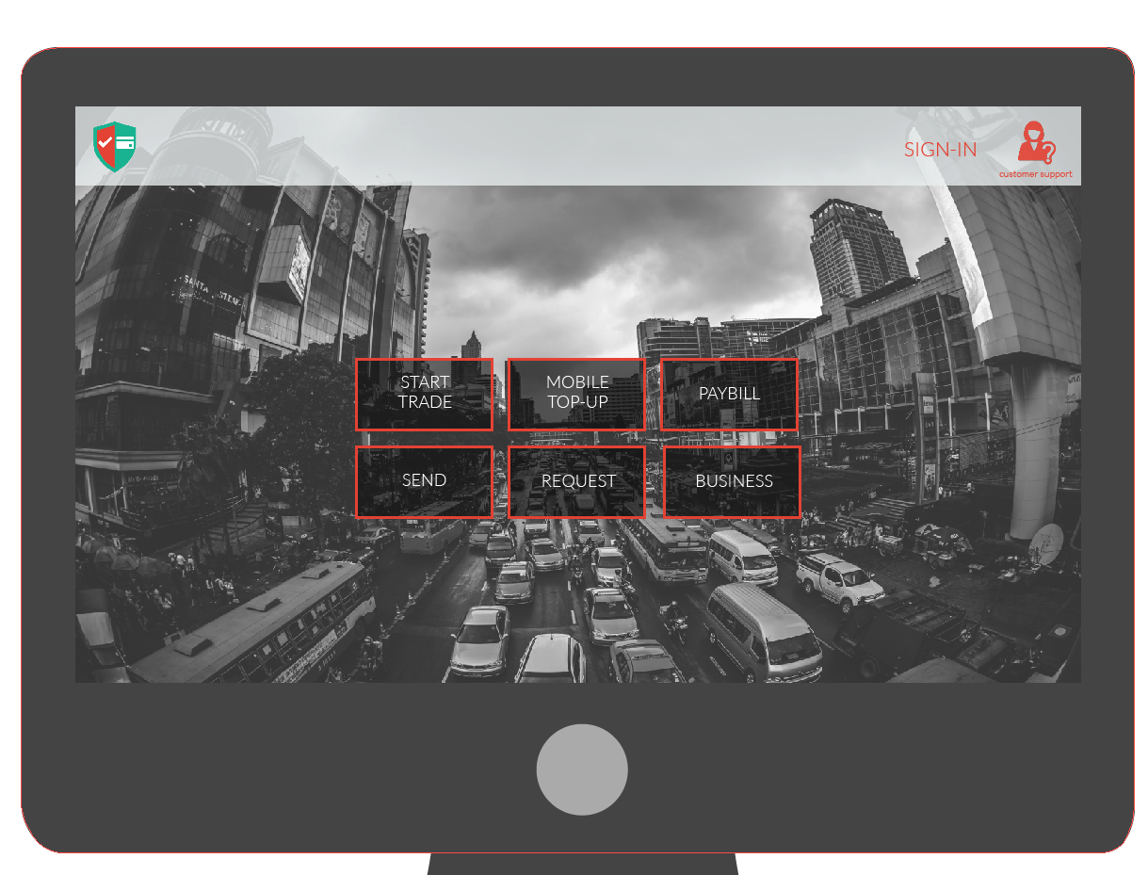
User Experience Outline

Slide 17
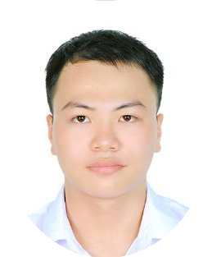
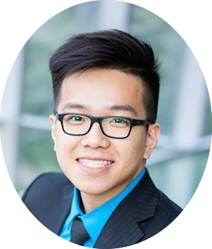



Who are we?
“Meet the passionate people behind the idea”
Dac Khue Nguyen
Huy Le
Cheryl Fong
Co-founder
Computer Science
Founder
Finance and IT
Co-Founder
Electrical Engineering

Slide 18
October
OUTREACH
RESEARCH
SKILL BUILDING
September
August
July
June
LucLoi.vn Domain
Formed the TEAM
May
Our Growth
2015
IDEA

Slide 19
Feedback and Q&A
THANK YOU
Hello@
aseanecom.com

